Slide 1
Recurrent Neural Language Models
CSCI 601-471/671 (NLP: Self-Supervised Models)
https://self-supervised.cs.jhu.edu/sp2024/

Slide 2
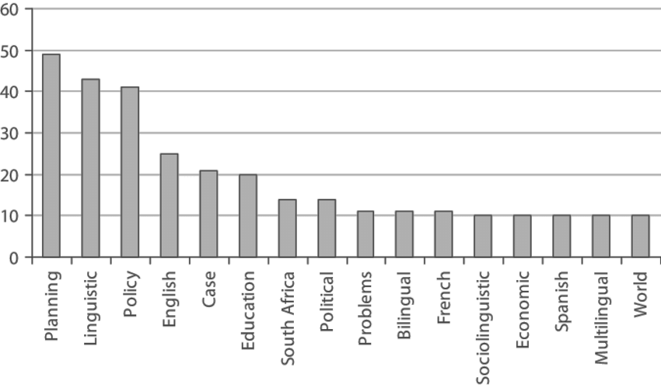
Recap
Prob
Softmax
mat
table
bed
desk
chair
Linear
Neural Language Models: neural networks trained with LM objective.
Fixed-window Neural LM: first of many neural LMs we will see in this class.
xN
Add & Norm
Feed-Forward layer
concatenate
O O O
O O O
O O O
O O O
lookup embeddings
and
our
problems
turning
into
context words in window of size 4 target word

Slide 3
What Changed from N-Gram LMs to Neural LMs?
What is the source of Neural LM’s strength?
Why sparsity is less of an issue for Neural LMs?
Answer: In n-grams, we treat all prefixes independently of each other! (even those that are semantically similar)
students opened their ___
pupils opened their ___
scholars opened their ___
undergraduates opened their ___
students turned the pages of their ___ students attentively perused their ___
...
Neural LMs are able to share information across these semantically-similar prefixes and overcome the sparsity issue.

Slide 4
Moving Beyond Feedforward Neural LMs
Prob
mat
table
bed
desk
chair
Softmax
Are competitive at language modeling task
However, they
have difficulty in remembering long range dependencies
have a fixed window size
Key question: how to better capture long-range dependencies?
Alternative here: a new family of neural networks: recurrent nets
Linear
xN
Add & Norm
Feed-Forward layer
concatenate
O O O
O O O
O O O
O O O
lookup embeddings
and
our
problems
turning
into
context words in window of size 4 target word

Slide 5
Summary
TODO

Slide 6
Moving beyond Feedforward Nets:
Recurrent Neural Networks

Slide 7
Infinite Use of Finite Model
Main question: how can a finite model a long (infinite) context?
Solution: recursion! (recursive use of a model)
RNNs are a family of neural networks introduced to learn sequential data via recursive dynamics.
Inspired by the temporality of human thoughts
[Jeff Elman, “Finding structure in time,” 1990]

Slide 8
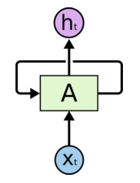
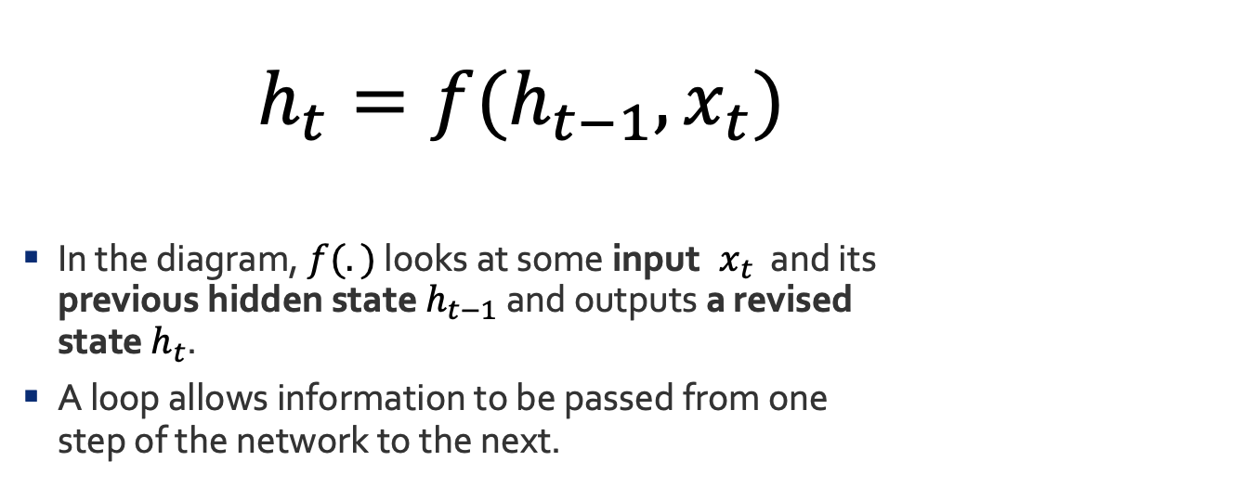
Recurrent Neural Networks (RNNs)
new state
old state
Input vector at t
$h_{t}=f(h_{t−1}, x_{t})$
In the diagram, $f(.)$ looks at some input $x_{t}$ and its previous hidden state $h_{t−1}$ and outputs a revised state $h_{t}$.
A loop allows information to be passed from one step of the network to the next.
[Jeff Elman, “Finding structure in time,” 1990]

Slide 9
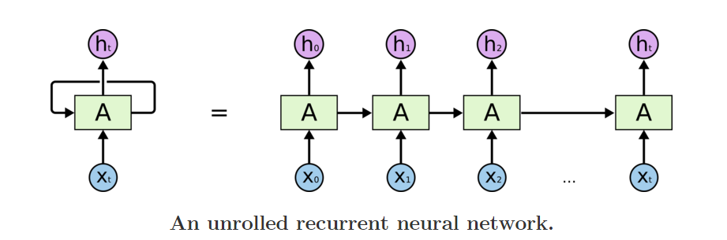
Unrolling RNN
The diagram above shows what happens if we unroll the loop.
A recurrent neural network can be thought of as multiple copies of the same network, each passing a message to a successor.
time
[Jeff Elman, “Finding structure in time,” 1990]

Slide 10
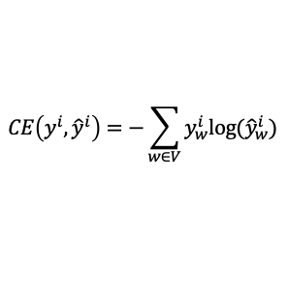

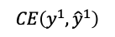
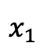


RNN: Forward Propagation
$$CE\left(y^{i},{\hat{y}}^{i}\right)=−\sum_{w∈V}{y_{w}^{i}\text{log}({\hat{y}}_{w}^{i})}$$
Error
$$CE\left(y^{1},{\hat{y}}^{1}\right)$$
$${\hat{y}}_{1}$$
Output layer
$$U$$
Hidden layer
$$W$$
Input layer
$$x_{1}$$
She

Slide 11


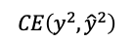

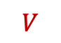
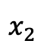
RNN: Forward Propagation
$$CE\left(y^{i},{\hat{y}}^{i}\right)=−\sum_{w∈V}{y_{w}^{i}\text{log}({\hat{y}}_{w}^{i})}$$
Error
$$CE\left(y^{1},{\hat{y}}^{1}\right)$$
$$CE\left(y^{2},{\hat{y}}^{2}\right)$$
$${\hat{y}}_{1}$$
$${\hat{y}}_{2}$$
Output layer
$$U$$
$$U$$
$$V$$
Hidden layer
$$W$$
$$W$$
Input layer
$$x_{1}$$
$$x_{2}$$
She
went

Slide 12

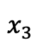
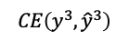


RNN: Forward Propagation
$$CE\left(y^{i},{\hat{y}}^{i}\right)=−\sum_{w∈V}{y_{w}^{i}\text{log}({\hat{y}}_{w}^{i})}$$
Error
$$CE\left(y^{1},{\hat{y}}^{1}\right)$$
$$CE\left(y^{2},{\hat{y}}^{2}\right)$$
$$CE\left(y^{3},{\hat{y}}^{3}\right)$$
$${\hat{y}}_{1}$$
$${\hat{y}}_{2}$$
$${\hat{y}}_{3}$$
Output layer
$$U$$
$$U$$
$$U$$
$$V$$
$$V$$
Hidden layer
$$W$$
$$W$$
$$W$$
Input layer
$$x_{1}$$
$$x_{2}$$
$$x_{3}$$
She
went
to

Slide 13


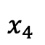
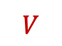

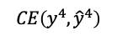
RNN: Forward Propagation
$$CE\left(y^{i},{\hat{y}}^{i}\right)=−\sum_{w∈V}{y_{w}^{i}\text{log}({\hat{y}}_{w}^{i})}$$
Error
$$CE\left(y^{1},{\hat{y}}^{1}\right)$$
$$CE\left(y^{2},{\hat{y}}^{2}\right)$$
$$CE\left(y^{3},{\hat{y}}^{3}\right)$$
$$CE\left(y^{4},{\hat{y}}^{4}\right)$$
$${\hat{y}}_{1}$$
$${\hat{y}}_{2}$$
$${\hat{y}}_{3}$$
$${\hat{y}}_{4}$$
Output layer
$$U$$
$$U$$
$$U$$
$$U$$
$$V$$
$$V$$
$$V$$
Hidden layer
$$W$$
$$W$$
$$W$$
$$W$$
Input layer
$$x_{1}$$
$$x_{2}$$
$$x_{3}$$
$$x_{4}$$
She
went
to
class

Slide 14
Summary
TODO

Slide 15
Training RNNs

Slide 16
RNN: Forward Propagation
$$CE\left(y^{i},{\hat{y}}^{i}\right)=−\sum_{w∈V}{y_{w}^{i}\text{log}({\hat{y}}_{w}^{i})}$$
Error
$$CE\left(y^{1},{\hat{y}}^{1}\right)$$
$${\hat{y}}_{1}$$
Output layer
$$U$$
Hidden layer
$$W$$
Input layer
$$x_{1}$$
She

Slide 17
RNN: Forward Propagation
$$CE\left(y^{i},{\hat{y}}^{i}\right)=−\sum_{w∈V}{y_{w}^{i}\text{log}({\hat{y}}_{w}^{i})}$$
Error
$$CE\left(y^{1},{\hat{y}}^{1}\right)$$
$$CE\left(y^{2},{\hat{y}}^{2}\right)$$
$${\hat{y}}_{1}$$
$${\hat{y}}_{2}$$
Output layer
$$U$$
$$U$$
$$V$$
Hidden layer
$$W$$
$$W$$
Input layer
$$x_{1}$$
$$x_{2}$$
She
went

Slide 18
RNN: Forward Propagation
$$CE\left(y^{i},{\hat{y}}^{i}\right)=−\sum_{w∈V}{y_{w}^{i}\text{log}({\hat{y}}_{w}^{i})}$$
Error
$$CE\left(y^{1},{\hat{y}}^{1}\right)$$
$$CE\left(y^{2},{\hat{y}}^{2}\right)$$
$$CE\left(y^{3},{\hat{y}}^{3}\right)$$
$${\hat{y}}_{1}$$
$${\hat{y}}_{2}$$
$${\hat{y}}_{3}$$
Output layer
$$U$$
$$U$$
$$U$$
$$V$$
$$V$$
Hidden layer
$$W$$
$$W$$
$$W$$
Input layer
$$x_{1}$$
$$x_{2}$$
$$x_{3}$$
She
went
to

Slide 19
RNN: Forward Propagation
$$CE\left(y^{i},{\hat{y}}^{i}\right)=−\sum_{w∈V}{y_{w}^{i}\text{log}({\hat{y}}_{w}^{i})}$$
Error
$$CE\left(y^{1},{\hat{y}}^{1}\right)$$
$$CE\left(y^{2},{\hat{y}}^{2}\right)$$
$$CE\left(y^{3},{\hat{y}}^{3}\right)$$
$$CE\left(y^{4},{\hat{y}}^{4}\right)$$
$${\hat{y}}_{1}$$
$${\hat{y}}_{2}$$
$${\hat{y}}_{3}$$
$${\hat{y}}_{4}$$
Output layer
$$U$$
$$U$$
$$U$$
$$U$$
$$V$$
$$V$$
$$V$$
Hidden layer
$$W$$
$$W$$
$$W$$
$$W$$
Input layer
$$x_{1}$$
$$x_{2}$$
$$x_{3}$$
$$x_{4}$$
She
went
to
class

Slide 20
RNN: Forward Propagation
$$CE\left(y^{i},{\hat{y}}^{i}\right)=−\sum_{w∈V}{y_{w}^{i}\text{log}({\hat{y}}_{w}^{i})}$$
Error
$$CE\left(y^{1},{\hat{y}}^{1}\right)$$
$$CE\left(y^{2},{\hat{y}}^{2}\right)$$
$$CE\left(y^{3},{\hat{y}}^{3}\right)$$
$$CE\left(y^{4},{\hat{y}}^{4}\right)$$
During training, regardless of our output predictions, we feed in the correct inputs
$${\hat{y}}_{1}$$
$${\hat{y}}_{2}$$
$${\hat{y}}_{3}$$
$${\hat{y}}_{4}$$
Output layer
$$U$$
$$U$$
$$U$$
$$U$$
$$V$$
$$V$$
$$V$$
Hidden layer
$$W$$
$$W$$
$$W$$
$$W$$
Input layer
$$x_{1}$$
$$x_{2}$$
$$x_{3}$$
$$x_{4}$$
She
went
to
class

Slide 21

RNN: Forward Propagation
$$CE\left(y^{i},{\hat{y}}^{i}\right)=−\sum_{w∈V}{y_{w}^{i}\text{log}({\hat{y}}_{w}^{i})}$$
Error
$$CE\left(y^{1},{\hat{y}}^{1}\right)$$
$$CE\left(y^{2},{\hat{y}}^{2}\right)$$
$$CE\left(y^{3},{\hat{y}}^{3}\right)$$
$$CE\left(y^{4},{\hat{y}}^{4}\right)$$
went?
over?
class?
after?
Output layer
$$\hat{y}$$
$$U$$
$$U$$
$$U$$
$$U$$
$$V$$
$$V$$
$$V$$
Hidden layer
$$W$$
$$W$$
$$W$$
$$W$$
Input layer
She
went
to
class

Slide 22
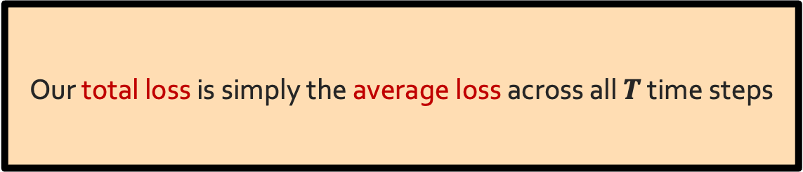
RNN: Forward Propagation
$$CE\left(y^{i},{\hat{y}}^{i}\right)=−\sum_{w∈V}{y_{w}^{i}\text{log}({\hat{y}}_{w}^{i})}$$
Error
$$CE\left(y^{1},{\hat{y}}^{1}\right)$$
$$CE\left(y^{2},{\hat{y}}^{2}\right)$$
$$CE\left(y^{3},{\hat{y}}^{3}\right)$$
$$CE\left(y^{4},{\hat{y}}^{4}\right)$$
went?
over?
class?
after?
Output layer
$$\hat{y}$$
$$U$$
$$U$$
$$U$$
$$U$$
$$V$$
$$V$$
$$V$$
Hidden layer
Our total loss is simply the average loss across all $T$ time steps
$$W$$
$$W$$
$$W$$
$$W$$
Input layer
She
went
to
class

Slide 23







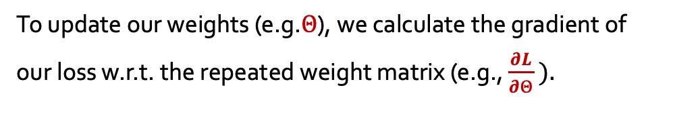


Backward Step
To update our weights (e.g.$Θ$), we calculate the gradient of our loss w.r.t. the repeated weight matrix (e.g., $\frac{∂L}{∂Θ} ).$
$$CE\left(y^{4},{\hat{y}}^{4}\right)$$
went?
over?
class?
after?
Using the chain rule, we trace the derivative all the way back to the beginning, while summing the results.
Output layer
$$\hat{y}$$
$$U$$
$$U$$
$$U$$
$$U$$
$$V$$
$$V$$
$$V$$
Hidden layer
$$W$$
$$W$$
$$W$$
$$W$$
Input layer
She
went
to
class

Slide 24
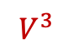
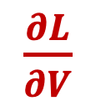
Backward Step
$\frac{∂L}{∂V}$
To update our weights (e.g.$Θ$), we calculate the gradient of our loss w.r.t. the repeated weight matrix (e.g., $\frac{∂L}{∂Θ} ).$
$$CE\left(y^{4},{\hat{y}}^{4}\right)$$
went?
over?
class?
Using the chain rule, we trace the derivative all the way back to the beginning, while summing the results.
Output layer
$$\hat{y}$$
$$U$$
$$U$$
$$U$$
$$U$$
$$V$$
$$V$$
$$V^{3}$$
Hidden layer
$$W$$
$$W$$
$$W$$
$$W$$
Input layer
She
went
to
class

Slide 25
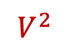
Backward Step
$\frac{∂L}{∂V}$
To update our weights (e.g.$Θ$), we calculate the gradient of our loss w.r.t. the repeated weight matrix (e.g., $\frac{∂L}{∂Θ} ).$
$$CE\left(y^{4},{\hat{y}}^{4}\right)$$
went?
over?
class?
Using the chain rule, we trace the derivative all the way back to the beginning, while summing the results.
Output layer
$$\hat{y}$$
$$U$$
$$U$$
$$U$$
$$U$$
$$V$$
$$V^{2}$$
$$V^{3}$$
Hidden layer
$$W$$
$$W$$
$$W$$
$$W$$
Input layer
She
went
to
class

Slide 26
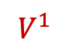
Backward Step
$\frac{∂L}{∂V}$
To update our weights (e.g.$Θ$), we calculate the gradient of our loss w.r.t. the repeated weight matrix (e.g., $\frac{∂L}{∂Θ} ).$
$$CE\left(y^{4},{\hat{y}}^{4}\right)$$
went?
over?
class?
Using the chain rule, we trace the derivative all the way back to the beginning, while summing the results.
Output layer
$$\hat{y}$$
$$U$$
$$U$$
$$U$$
$$U$$
$$V^{1}$$
$$V^{2}$$
$$V^{3}$$
Hidden layer
$$W$$
$$W$$
$$W$$
$$W$$
Input layer
She
went
to
class

Slide 27
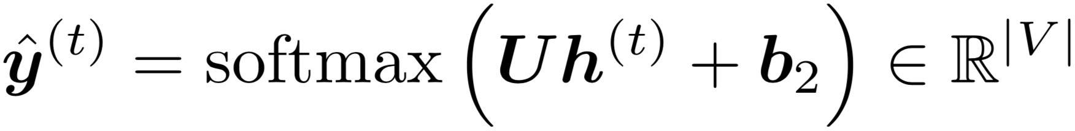
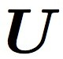
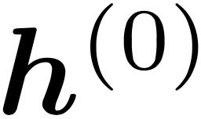
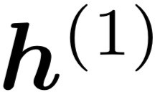
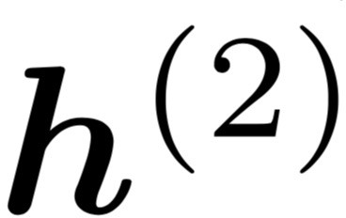
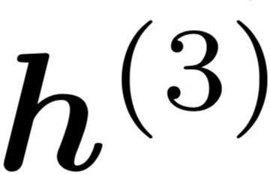
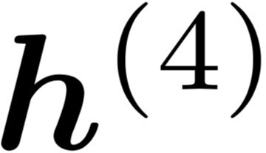
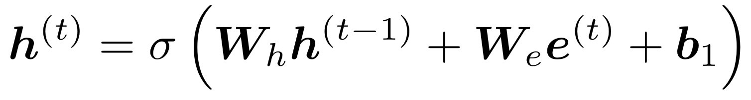



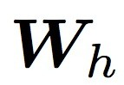

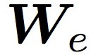




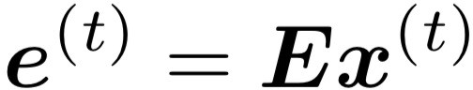
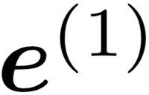
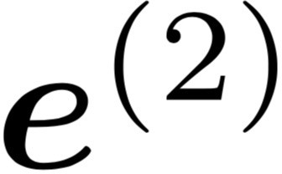
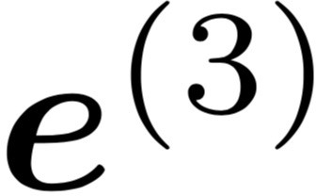
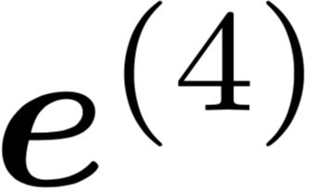
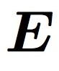
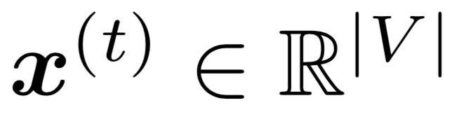
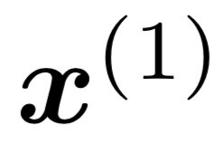
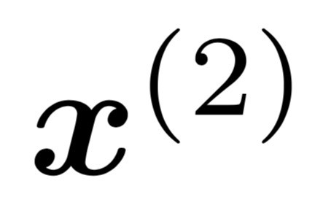
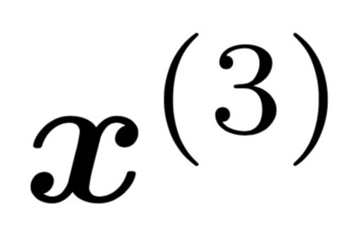
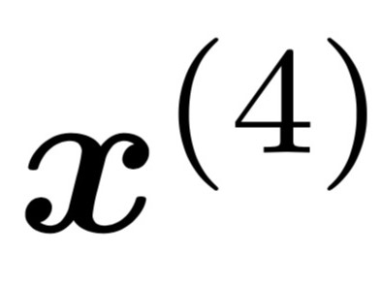
LMs w/ Recurrent Neural Nets
[adopted from Chris Manning]
books
laptops
Core idea: apply a model repeatedly
outputs
output distribution
is the initial hidden state
hidden states
word embeddings
Input
embedding
words / one-hot vectors
the
cat
sat
on
this input sequence could be much longer

Slide 28
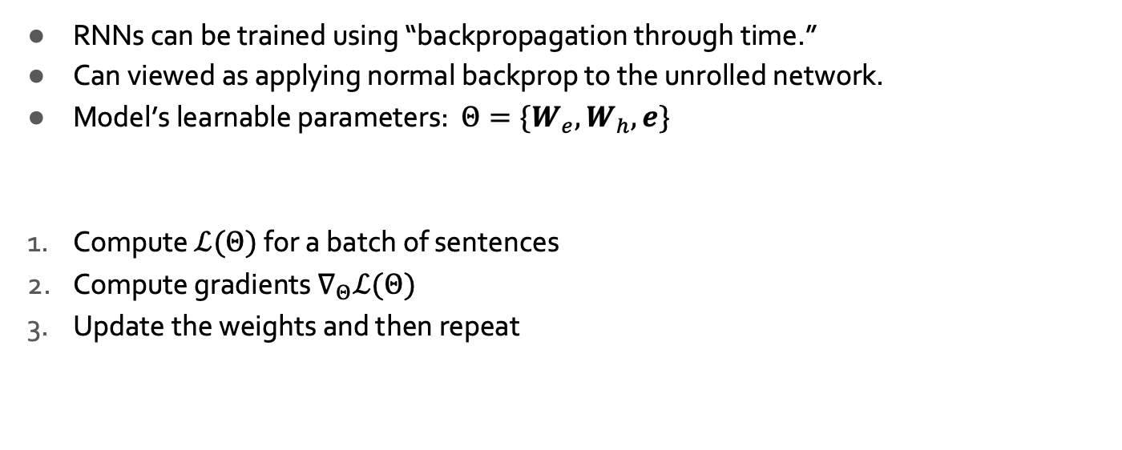
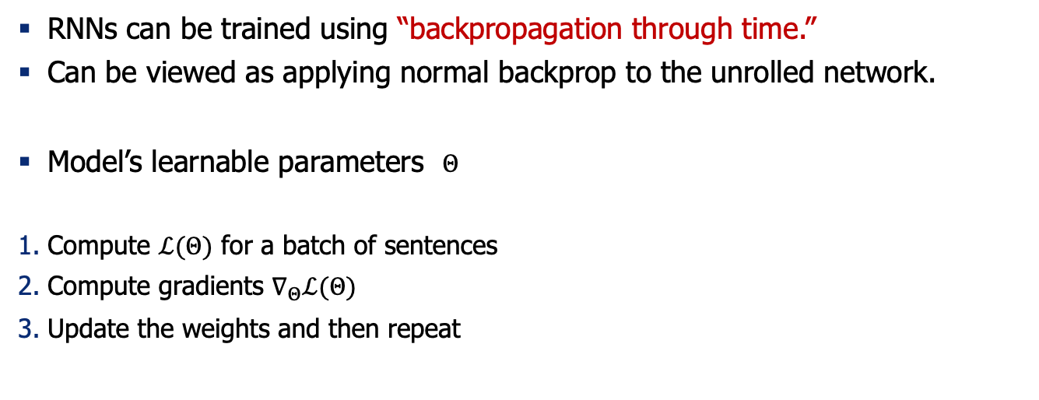
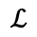
Training RNNs: Summary
backpropagated feedback
$$ℒ$$
books
laptops
RNNs can be trained using “backpropagation through time.”
Can be viewed as applying normal backprop to the unrolled network.
Model’s learnable parameters $Θ$
Compute $ℒ(Θ)$ for a batch of sentences
Compute gradients $∇_{Θ}ℒ(Θ)$
Update the weights and then repeat
the
cat
sat
on

Slide 29
Recurrent Neural Networks and Natural Language

Slide 30
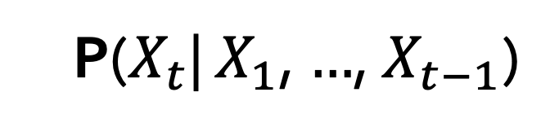
LMs w/ Recurrent Neural Nets
We feed the words one at a time to the RNN.
A predictive head uses the latest embedding vector to produce a probability over the vocabulary.
P($X_{t}$| $X_{1}$, $…$, $X_{t−1}$)
next word
context

Slide 31




RNN to Map Sequence to Another Sequence (aka Seq2Seq)
_{ℎ}𝐸
_{ℎ}𝐸
_{ℎ}𝐸
_{ℎ}𝐸
1
2
3
4
Hidden layer
Input layer
The brown
dog
ran
ENCODER RNN

Slide 32
RNN to Map Sequence to Another Sequence (aka Seq2Seq)
The final hidden state of the encoder RNN is the initial state of the decoder RNN
_{ℎ}𝐸
_{ℎ}𝐸
_{ℎ}𝐸
_{ℎ}𝐸
1
2
3
4
Hidden layer
Input layer
The brown
dog
ran
ENCODER RNN

Slide 33


RNN to Map Sequence to Another Sequence (aka Seq2Seq)
The final hidden state of the encoder RNN is the initial state of the decoder RNN
_{ℎ}𝐸
_{ℎ}𝐸
_{ℎ}𝐸
_{ℎ}𝐸
_{ℎ}𝐷
1
2
3
4
1
Hidden layer
Input layer
The brown
dog
ran
<s>
ENCODER RNN
DECODER RNN

Slide 34
RNN to Map Sequence to Another Sequence (aka Seq2Seq)
The final hidden state of the encoder RNN is the initial state of the decoder RNN
Le
_{ℎ}𝐸
_{ℎ}𝐸
_{ℎ}𝐸 _{ℎ}𝐸
3 4
_{ℎ}𝐷
1
2
1
Hidden layer
Input layer
The brown
dog
ran
<s>
ENCODER RNN
DECODER RNN

Slide 35
RNN to Map Sequence to Another Sequence (aka Seq2Seq)
The final hidden state of the encoder RNN is the initial state of the decoder RNN
Le
_{ℎ}𝐸
_{ℎ}𝐸
_{ℎ}𝐸 _{ℎ}𝐸
3 4
_{ℎ}𝐷 _{ℎ}𝐷
1 2
1
2
Hidden layer
Input layer
The brown
dog
ran
<s>
Le
ENCODER RNN
DECODER RNN

Slide 36
RNN to Map Sequence to Another Sequence (aka Seq2Seq)
The final hidden state of the encoder RNN is the initial state of the decoder RNN
Le chien
_{ℎ}𝐸
_{ℎ}𝐸
_{ℎ}𝐸 _{ℎ}𝐸
3 4
_{ℎ}𝐷 _{ℎ}𝐷
1 2
1
2
Hidden layer
Input layer
The brown
dog
ran
<s>
Le
ENCODER RNN
DECODER RNN

Slide 37
RNN to Map Sequence to Another Sequence (aka Seq2Seq)
The final hidden state of the encoder RNN is the initial state of the decoder RNN
Le chien
_{ℎ}𝐸
_{ℎ}𝐸
_{ℎ}𝐸 _{ℎ}𝐸
3 4
_{ℎ}𝐷 _{ℎ}𝐷
1 2
_{ℎ}𝐷
1
2
3
Hidden layer
Input layer
The brown
dog
ran
<s>
Le
chien
ENCODER RNN
DECODER RNN

Slide 38
RNN to Map Sequence to Another Sequence (aka Seq2Seq)
The final hidden state of the encoder RNN is the initial state of the decoder RNN
Le chien
brun
_{ℎ}𝐸
_{ℎ}𝐸
_{ℎ}𝐸 _{ℎ}𝐸
3 4
_{ℎ}𝐷 _{ℎ}𝐷
1 2
_{ℎ}𝐷
1
2
3
Hidden layer
Input layer
The brown
dog
ran
<s>
Le
chien
ENCODER RNN
DECODER RNN

Slide 39
RNN to Map Sequence to Another Sequence (aka Seq2Seq)
The final hidden state of the encoder RNN is the initial state of the decoder RNN
Le chien
brun
_{ℎ}𝐸
_{ℎ}𝐸
_{ℎ}𝐸 _{ℎ}𝐸
3 4
_{ℎ}𝐷 _{ℎ}𝐷
1 2
_{ℎ}𝐷
_{ℎ}𝐷
1
2
3
4
Hidden layer
Input layer
The brown
dog
ran
<s>
Le
chien
brun
ENCODER RNN
DECODER RNN

Slide 40
RNN to Map Sequence to Another Sequence (aka Seq2Seq)
The final hidden state of the encoder RNN is the initial state of the decoder RNN
Le chien
brun a
couru <s>
_{ℎ}𝐸
_{ℎ}𝐸
_{ℎ}𝐸 _{ℎ}𝐸
3 4
_{ℎ}𝐷 _{ℎ}𝐷
1 2
_{ℎ}𝐷
_{ℎ}𝐷
_{ℎ}𝐷 _{ℎ}𝐷
5 6
1
2
3
4
Hidden layer
Input layer
The brown
dog
ran
<s>
Le
chien
brun
a couru
ENCODER RNN
DECODER RNN

Slide 41
Summary

Slide 42
Generating text from RNN-LMs

Slide 43
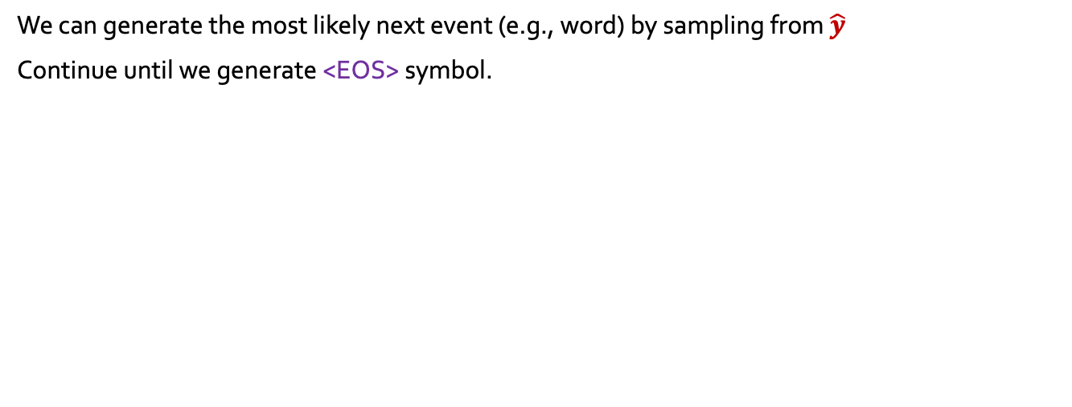
RNN: Generation
We can generate the most likely next event (e.g., word) by sampling from $\hat{y}$
Continue until we generate <EOS> symbol.

Slide 44
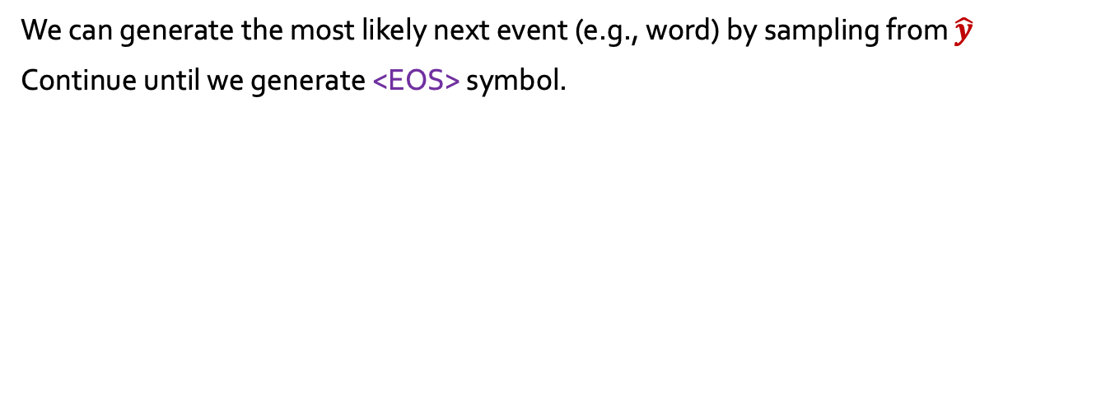
RNN: Generation
We can generate the most likely next event (e.g., word) by sampling from $\hat{y}$
Continue until we generate <EOS> symbol.
“Sorry”
Output layer
$$U$$
Hidden layer
$$W$$
Input layer
$$x_{1}$$
<START>

Slide 45
RNN: Generation
We can generate the most likely next event (e.g., word) by sampling from $\hat{y}$
Continue until we generate <EOS> symbol.
“Sorry”
Harry
Output layer
$$U$$
$$U$$
$$V$$
Hidden layer
$$W$$
$$W$$
Input layer
$$x_{1}$$
$$x_{2}$$
<START>
“Sorry”

Slide 46
RNN: Generation
We can generate the most likely next event (e.g., word) by sampling from $\hat{y}$
Continue until we generate <EOS> symbol.
“Sorry”
Harry
shouted,
Output layer
$$U$$
$$U$$
$$U$$
$$V$$
$$V$$
Hidden layer
$$W$$
$$W$$
$$W$$
Input layer
$$x_{1}$$
$$x_{2}$$
$$x_{3}$$
<START>
“Sorry”
Harry

Slide 47
RNN: Generation
We can generate the most likely next event (e.g., word) by sampling from $\hat{y}$
Continue until we generate <EOS> symbol.
“Sorry”
Harry
shouted,
panicking
Output layer
$$U$$
$$U$$
$$U$$
$$U$$
$$V$$
$$V$$
$$V$$
Hidden layer
$$W$$
$$W$$
$$W$$
$$W$$
Input layer
$$x_{1}$$
$$x_{2}$$
$$x_{3}$$
$$x_{4}$$
<START>
“Sorry”
Harry
shouted,

Slide 48
RNN: Generation
NOTE: we are transmitting contextual information over time.
“Sorry”
Harry
shouted,
panicking
Output layer
$$U$$
$$U$$
$$U$$
$$U$$
$$V$$
$$V$$
$$V$$
Hidden layer
$$W$$
$$W$$
$$W$$
$$W$$
Input layer
$$x_{1}$$
$$x_{2}$$
$$x_{3}$$
$$x_{4}$$
<START>
“Sorry”
Harry
shouted,

Slide 49

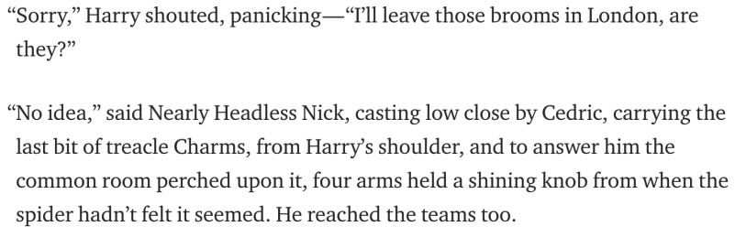
RNN: Generation
When trained on Harry Potter text, it generates:
Source: https://medium.com/deep-writing/harry-potter-written-by-artificial-intelligence-8a9431803da6

Slide 50
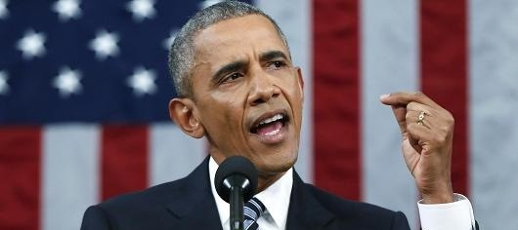
RNNs: Generation
RNN-LM trained on Obama speeches:
The United States will step up to the cost of a new challenges of the American people that will share the fact that we created the problem. They were attacked and so that they have to say that all the task of the final days of war that I will not be able to get this done.
https://medium.com/@samim/obama-rnn-machine-generated-political-speeches-c8abd18a2ea0

Slide 51

RNNs in Practice
RNN-LM trained on food recipes:
Title: CHOCOLATE RANCH BARBECUE
Categories: Game, Casseroles, Cookies, Cookies
Yield: 6 Servings
2 tb Parmesan cheese -- chopped
1 c Coconut milk
3 Eggs, beaten
Place each pasta over layers of lumps. Shape mixture into the moderate oven and simmer until firm. Serve hot in bodied fresh, mustard, orange and cheese. Combine the cheese and salt together the dough in a large skillet; add the ingredients and stir in the chocolate and pepper.
https://gist.github.com/nylki/1efbaa36635956d35bcc

Slide 52

Evaluation LMs with Perplexity (2016)
n-gram model →
Increasingly complex RNNs
Source: https://engineering.fb.com/2016/10/25/ml-applications/building-an-efficient-neural-language-model-over-a-billion-words/

Slide 53
Summary
TODO

Slide 54
RNN-LMs:
Pros and Cons

Slide 55
RNNs: Pros and Cons
books
laptops
Advantages:
Model size doesn’t increase for longer inputs — reusing a compact set of model parameters.
Computation for step t can (in theory) use information from many steps back
Disadvantages:
Recurrent computation is slow and difficult to parallelize.
Next week: self-attention mechanism, better at representing long sequences and also parallelizable.
While RNNs in theory can represent long sequences, they quickly forget portions of the input.
Vanishing/exploding gradients.
a
zoo
the students
opened
their

Slide 56

Vanishing/Exploding Gradient Problem
backpropagated feedback
$$ℒ$$
books
laptops
Backpropagated errors multiply at each layer, resulting in exponential decay (if derivative is small) or growth (if derivative is large).
Makes it very difficult train deep networks, or simple recurrent networks over many time steps.
$$∇_{ℒ}\left(W_{h}\right)={\left(J_{ℒ}\left(W_{L−1}\right)\right)}^{T}=\sum_{t=0}{{\left(J_{ℒ}\left(h^{(t)}\right){ J}_{h^{(t)}}\left(W_{h}\right)\right)}^{T}}$$
$$J_{ℒ}\left(h^{(0)}\right)=J_{h^{(1)}}\left(h^{(0)}\right)J_{h^{(2)}}\left(h^{(1)}\right) × … ×{ J}_{h^{(4)}}\left(h^{(3)}\right){ J}_{ℒ}\left(h^{(4)}\right)$$
chain rule
the
cat
sat
on
observed inputs

Slide 57
Vanishing/Exploding Gradient Problem
backpropagated feedback
$$ℒ$$
books
laptops
Gradient signal from far away is lost. So, model weights are updated only with respect to near effects, not long-term effects.
Note: instability of matrix powers can be determined from their eigenvalues.
$$J_{ℒ}\left(h^{(0)}\right)=J_{h^{(1)}}\left(h^{(0)}\right)J_{h^{(2)}}\left(h^{(1)}\right) × … ×{ J}_{h^{(4)}}\left(h^{(3)}\right){ J}_{ℒ}\left(h^{(4)}\right)$$
chain rule
the
cat
sat
on
observed inputs

Slide 58

RNNs: Difficulty in Learning Long-Range Dependencies
While RNNs in theory can represent long sequences, in practice teaching them about long-range dependencies is non-trivial.
Gradient clipping:
If the norm of the gradient is greater than some threshold, scale it down before applying SGD update.
Intuition: take a step in the same direction, but a smaller step
[“On the difficulty of training recurrent neural networks”, Pascanu et al, 2013]
Notes:
These models don’t guarantee that there is no vanishing/exploding gradient, but it does provide an easier way for the model to learn long-distance dependencies

Slide 59

RNNs: Difficulty in Learning Long-Range Dependencies (2)
While RNNs in theory can represent long sequences, in practice teaching them about long-range dependencies is non-trivial.
Using residual layers:
lots of new deep architectures (RNN or otherwise) add direct connections, thus allowing the gradient to flow)
"Deep Residual Learning for Image Recognition", He et al, 2015. https://arxiv.org/pdf/1512.03385.pdf
Notes:
These models don’t guarantee that there is no vanishing/exploding gradient, but it does provide an easier way for the model to learn long-distance dependencies

Slide 60

RNNs: Difficulty in Learning Long-Range Dependencies (3)
While RNNs in theory can represent long sequences, in practice teaching them about long-range dependencies is non-trivial.
Changes to the architecture makes it easier for the RNN to preserve information over many timesteps
Long Short-Term Memory (LSTM) [Hochreiter and Schmidhuber 1997, Gers+ 2000]
Gated Recurrent Units (GRU) [Cho+ 2014]
Notes:
These models don’t guarantee that there is no vanishing/exploding gradient, but it does provide an easier way for the model to learn long-distance dependencies

Slide 61
RNNs: Difficulty in Learning Long-Range Dependencies (3)
While RNNs in theory can represent long sequences, in practice teaching them about long-range dependencies is non-trivial.
Changes to the architecture makes it easier for the RNN to preserve information over many timesteps
Long Short-Term Memory (LSTM) [Hochreiter and Schmidhuber 1997, Gers+ 2000]
Gated Recurrent Units (GRU) [Cho+ 2014]
Many of these variants were the dominant architecture of In 2013–2015.
We will not cover these alternative architecture in favor or spending more time on more modern developments.
Notes:
These models don’t guarantee that there is no vanishing/exploding gradient, but it does provide an easier way for the model to learn long-distance dependencies

Slide 62

Adapting RNNs to Application
Text Classification
Language Modeling
POS Tags

Slide 63
Encoder-Decoder Architectures
It is useful to think of generative models as two sub-models.
Some model
“The cat sat on the [MASK]”

Slide 64
Encoder-Decoder Architectures
It is useful to think of generative models as two sub-models.
Representation (compression) of the context
Encoder
Decoder
“The cat sat on the [MASK]”
Processes the context and compiles it into a vector.
Produces the output sequence item by item using the representation of the context.

Slide 65

Encoder-Decoder Architectures
https://jalammar.github.io/visualizing-neural-machine-translation-mechanics-of-seq2seq-models-with-attention/

Slide 66

Encoder-Decoder Architectures

Slide 67


Extending RNNs to Both Directions
An RNN limitation: Hidden variables capture only one side of the context.
Solution: Bi-Directional RNNs
RNN
Bi-directional RNN

Slide 68
Summary
TODO

Slide 69
Algorithms for Sampling from Language Models

Slide 70

How do we generate language from LMs?
Given:
next word
context
P($X_{t}$| $X_{1}$, $…$, $X_{t−1}$)
Prob
mat
table
bed
desk
chair
Some model
“The cat sat on the [MASK]”

Slide 71

Approach 1: Greedy (Argmax)
Challenge:
Generates boring results — not creative.
May repeat itself .
“I went to the place that the place that the place that the place ...”
next word
context
$x_{t}$ =argmax P($X_{t}$| $X_{1}$, $…$, $X_{t−1}$)
Prob
mat
table
bed
desk
chair
Some model
“The cat sat on the [MASK]”
[The Curious Case of Neural Text Degeneration, Holtzman et al., 2020]

Slide 72

Approach 2: Sampling from the whole distribution
Challenge: Likely to result in lots of nonsensical generations.
Reason: LMs distribution is more meaningful about high-prob items, but as we get further away from high-prob items, the probs are less meaningful.
next word
context
$x_{t}$ ~ P($X_{t}$| $X_{1}$, $…$, $X_{t−1}$)
Prob
mat
table
bed
desk
chair
Some model
“The cat sat on the [MASK]”
[The Curious Case of Neural Text Degeneration, Holtzman et al., 2020]

Slide 73


Approach 3: Sampling + Temperature
Small-ish T would assign more prob to the top of the distribution, while not losing diversity.
Prob
mat
table
bed
desk
chair
Some model
“The cat sat on the [MASK]”
[The Curious Case of Neural Text Degeneration, Holtzman et al., 2020]

Slide 74
Approach 4: Top-p Sampling (Nucleus sampling)
On each step, randomly sample from the distribution, but restricted to just the top-p most probable words
Like pure sampling, but truncate the distribution to high-prob content
p=1 is basically sampling from the whole distribution
Prob
mat
table
bed
desk
chair
Some model
“The cat sat on the [MASK]”
[The Curious Case of Neural Text Degeneration, Holtzman et al., 2020]

Slide 75


Local Incoherence
[The Curious Case of Neural Text Degeneration, Holtzman et al., 2020]

Slide 76


Fancier Approaches: Beam Search
A heuristic search that allows maximizing words probabilities for a window of words
Out of scope for us. Feel free to check it in your own time.

Slide 77
Summary on Sampling Algorithms
Greedy decoding: a simple method; gives low quality output
Sampling methods are a way to get more diversity and randomness
Good for open-ended / creative generation (poetry, stories)
Top-p sampling allows you to control diversity
Others: Beam search searches for high-probability output

Slide 78
Pre-training Representations of RNNs

Slide 79
Recap: Recurrent Neural Networks
Repeated use of a finite model
“Sorry”
Harry
shouted,
panicking
Output layer
$$U$$
$$U$$
$$U$$
$$U$$
$$V$$
$$V$$
$$V$$
Hidden layer
$$W$$
$$W$$
$$W$$
$$W$$
Input layer
$$x_{1}$$
$$x_{2}$$
$$x_{3}$$
$$x_{4}$$
<START>
“Sorry”
Harry
shouted,

Slide 80
Recap: Encoder-Decoder Architectures
It is useful to think of generative models as two sub-models.
Some model
“The cat sat on the [MASK]”

Slide 81
Recap: Encoder-Decoder Architectures

Slide 82


ELMo: First Major Self-Supervised LM
General idea: Goal is to get highly rich, contextualized embeddings (word tokens)
Contextual representations, i.e., depend on the entire sentence in which a word is used.
[Deep contextualized word representations, Peters et al. 2018]

Slide 83

ELMo: First Major Self-Supervised LM
Use both directions of context (bi-directional), with increasing abstractions (stacked)
Two LSTMs in different directions — capture both directions
[Deep contextualized word representations, Peters et al. 2018]

Slide 84
ELMo: First Major Self-Supervised LM
Linearly combine all abstract representations (hidden layers) and optimize w.r.t. a particular task (e.g., sentiment classification)
[Deep contextualized word representations, Peters et al. 2018]

Slide 85


ELMo: Objective
[Deep contextualized word representations, Peters et al. 2018]

Slide 86
ELMo: Some Details
Train a forward LM and backward LMs
Use 4096 dim hidden states
Residual connections from the first to second layer
Trained 10 epochs on 1B Word Benchmark
Perplexity ~39
[Deep contextualized word representations, Peters et al. 2018]

Slide 87

ELMo Representations for Tasks
Fine-tune classifiers using contextualized word representations extracted from ELMo.
[Deep contextualized word representations, Peters et al. 2018]

Slide 88

ELMo: Evaluation
SQuAD: question answering
SNLI: textual entailment
SRL: semantic role labeling
Coref: coreference resolution
NER: named entity recognition
SST-5: sentiment analysis
[Deep contextualized word representations, Peters et al. 2018]

Slide 89

Experimental Results
[Deep contextualized word representations, Peters et al. 2018]

Slide 90



Syntactic information is better represented at lower layers while semantic information is captured a higher layers
[Deep contextualized word representations, Peters et al. 2018]

Slide 91
A broader lesson: Pre-training + Fine-tuning
Let’s say I want to train a model for sentiment analysis
In the past, I would simply train a supervised model on Word2Vec representation of review sentences (e.g., HW2).
A self-supervised model
A self-supervised model
step 1:
self-supervised pretraining
step 2:
supervised fine-tuning
A ton of unlabeled text
A ton of unlabeled text

Slide 92
A broader lesson: Pre-training + Fine-tuning
Contextual representation of LMs is much stronger than word-level ones.
Now that we have Fixed-Window LM, we can use it to build better classifiers!
A self-supervised model
A self-supervised model
step 1:
self-supervised pretraining
step 2:
supervised fine-tuning
A ton of unlabeled text
A ton of unlabeled text

Slide 93

Summary
ELMo: Stacked Bi-directional LSTMs
ELMo yielded incredibly good contextualized embeddings, which yielded SOTA results when applied to many NLP tasks.
Main ELMo takeaway: given enough [unlabeled] training data, having tons of explicit connections between your vectors is useful — the system can determine how to best use context.
[Deep contextualized word representations, Peters et al. 2018]

Slide 94

Summary
Recurrent Neural Networks
A family of neural networks that allow architecture for inputs of variable length
RNN-LM: LM based on RNNs
A notable example: ELMo
Cons:
Sequential processing
While in theory it maintain infinite history, in practice it suffers from long-range dependencies.

Slide 95
Atomic Units of Language

Slide 96
The cat sat on the mat.
Notes:
The …

Slide 97
The cat sat on the mat.
words split based on white space?
BOS, The, cat, sat, on, the, mat, ., EOS
characters?
BOS, T, h, e, SPACE, c, a, t, SPACE, s, …
bytes??!
011000010111000001110000011011000110010101100001
1110000011100000110110001100101011000010111000 …
Notes:
The …

Slide 98
The cat sat on the mat.
words split based on white space?
BOS, The, cat, sat, on, the, mat, ., EOS
characters?
BOS, T, h, e, SPACE, c, a, t, SPACE, s, …
bytes??!
011000010111000001110000011011000110010101100001
1110000011100000110110001100101011000010111000 …
Which one should we use as the atomic building blocks for modeling language? 🤔
Notes:
The …

Slide 99
Cost of Using Word Units
What happens when we encounter a word at test time that we’ve never seen in our training data?
Loquacious:
Omnishambles:
COVID-19: was unseen until 2020!
Aquire: incorrect spelling of “acquire”
Acknowleadgement: incorrect spelling of “acknowledgement”
What about relevant words?: “dog” vs “dogs”; ”run” vs “running”
With word level tokenization, we have no way of understanding an unseen word!
Also, not all languages have spaces between words like English!
Tending to talk a great deal; talkative.
A situation that has been mismanaged, due to blunders and miscalculations.

Slide 100

Cost of Using Character Units
What if we use characters?
Pro: (1) small vocabulary, just the number of unique characters in the training data. (2) fewer out-of-vocabulary tokens
Cost: much longer input sequences As we discussed, modeling long-range dependences is challenging.

Slide 101

Subword Tokenization
Breaks words into smaller units that are indicative of their morphological construction.
Developed for machine translation (Sennrich et al. 2016)
Dominantly used in modern language models (BERT, T5, GPT, …)
Relies on a simple algorithm called byte pair encoding (Gage, 1994)
[Improving Neural Machine Translation Models with Monolingual Data, Sennrich et al. 2016]
[A new algorithm for data compression, Gage 1994]

Slide 102
from transformers import AutoTokenizer
tokenizer = AutoTokenizer.from_pretrained("bert-base-cased")
sequence = "Using a Transformer network is simple"
print(tokenizer.tokenize(sequence))
['Using', 'a', ‘Transform', '##er', 'network', 'is', 'simple’]
print(tokenizer.convert_tokens_to_ids(tokens))
[7993, 170, 13809, 23763, 2443, 1110, 3014]
tokenizer = AutoTokenizer.from_pretrained("albert-base-v1")
sequence = "Using a Transformer network is simple"
print(tokenizer.tokenize(sequence))
[‘_using', ‘_a', ‘_transform', 'er', ‘_network', ‘_is', ‘_simple’]

Slide 103
The Tokenization Pipeline
Normalization
Tokenization
Pos-processing
Pre-tokenization
Strip extra spaces
Unicode normalization, …

Slide 104
The Tokenization Pipeline
Normalization
Tokenization
Pos-processing
Pre-tokenization
White spaces between words and sentences
Punctuations
…

Slide 105
The Tokenization Pipeline
Normalization
Tokenization
Pos-processing
Pre-tokenization
BPE, …. (will discuss this in a second)

Slide 106
The Tokenization Pipeline
Normalization
Tokenization
Pos-processing
Pre-tokenization
Add special tokens: for example [CLS], [SEP] for BERT
Truncate to match the maximum length of the model
Pad all sentences in a batch to the same length

Slide 107
Byte-pair Encoding (BPE)
An algorithm for forming subword tokens based on a collection of raw text.
and there are no re ##fueling stations anywhere
One of the city’s more un ##princi ##pled real state agents
[Improving Neural Machine Translation Models with Monolingual Data, Sennrich et al. 2016]
[A new algorithm for data compression, Gage 1994]

Slide 108

Byte-pair Encoding (BPE)
Idea: Repeatedly merge the most frequent adjacent tokens
Doing 30k merges => vocabulary of around 30k subwords. Includes many whole words.
[Improving Neural Machine Translation Models with Monolingual Data, Sennrich et al. 2016]
[A new algorithm for data compression, Gage 1994]

Slide 109
Byte-pair Encoding (BPE): Example
Form base vocabulary of all characters that occur in the training set.
Example:
Our (very fascinating🙄) training data: “jhu jhu jhu hopkins hop hops hops”
Base vocab: h, i, j, k, n, o, p, s, u
Tokenized data: j h u j h u j h u h o p k i n s h o p h o p s h o p s
Does not show the word separator for simplicity.
[Improving Neural Machine Translation Models with Monolingual Data, Sennrich et al. 2016]
[A new algorithm for data compression, Gage 1994]

Slide 110
Byte-pair Encoding: Example (2)
Count the frequency of each token pair in the data
Example:
Our (very fascinating🙄) training data: “jhu jhu jhu hopkins hop hops hops”
Base vocab: h, i, j, k, n, o, p, s, u
Tokenized data: j h u j h u j h u h o p k i n s h o p h o p s h o p s
Token pair frequencies:
j + h -> 3
h + u -> 3
h + o -> 4
o + p -> 4
p + k -> 1
k + i -> 1
….
[Improving Neural Machine Translation Models with Monolingual Data, Sennrich et al. 2016]
[A new algorithm for data compression, Gage 1994]

Slide 111
Byte-pair Encoding: Example (3)
Choose the pair that occurs more, merge them and add to vocab.
Example:
Our (very fascinating🙄) training data: “jhu jhu jhu hopkins hop hops hops”
Base vocab: h, i, j, k, n, o, p, s, u
Tokenized data: j h u j h u j h u h o p k i n s h o p h o p s h o p s
Token pair frequencies:
j + h -> 3
h + u -> 3
h + o -> 4
o + p -> 4
p + k -> 1
k + i -> 1
….
[Improving Neural Machine Translation Models with Monolingual Data, Sennrich et al. 2016]
[A new algorithm for data compression, Gage 1994]

Slide 112
Byte-pair Encoding: Example (4)
Choose the pair that occurs more, merge them and add to vocab.
Example:
Our (very fascinating🙄) training data: “jhu jhu jhu hopkins hop hops hops”
Base vocab: h, i, j, k, n, o, p, s, u, ho
Tokenized data: j h u j h u j h u h o p k i n s h o p h o p s h o p s
Token pair frequencies:
j + h -> 3
h + u -> 3
h + o -> 4
o + p -> 4
p + k -> 1
k + i -> 1
….
[Improving Neural Machine Translation Models with Monolingual Data, Sennrich et al. 2016]
[A new algorithm for data compression, Gage 1994]

Slide 113
Byte-pair Encoding: Example (5)
Retokenize the data
Example:
Our (very fascinating🙄) training data: “jhu jhu jhu hopkins hop hops hops”
Base vocab: h, i, j, k, n, o, p, s, u, ho
Tokenized data: j h u j h u j h u ho p k i n s ho p ho p s ho p s
Token pair frequencies:
[Improving Neural Machine Translation Models with Monolingual Data, Sennrich et al. 2016]
[A new algorithm for data compression, Gage 1994]

Slide 114
Byte-pair Encoding: Example (6)
Count the token pairs and merge the most frequent one
Example:
Our (very fascinating🙄) training data: “jhu jhu jhu hopkins hop hops hops”
Base vocab: h, i, j, k, n, o, p, s, u, ho
Tokenized data: j h u j h u j h u ho p k i n s ho p ho p s ho p s
Token pair frequencies:
j + h -> 3
h + u -> 3
ho + p -> 4
p + k -> 1
k + i -> 1
i + n -> 1
….
[Improving Neural Machine Translation Models with Monolingual Data, Sennrich et al. 2016]
[A new algorithm for data compression, Gage 1994]

Slide 115
Byte-pair Encoding: Example (7)
Count the token pairs and merge the most frequent one
Example:
Our (very fascinating🙄) training data: “jhu jhu jhu hopkins hop hops hops”
Base vocab: h, i, j, k, n, o, p, s, u, ho
Tokenized data: j h u j h u j h u ho p k i n s ho p ho p s ho p s
Token pair frequencies:
j + h -> 3
h + u -> 3
ho + p -> 4
p + k -> 1
k + i -> 1
i + n -> 1
….
[Improving Neural Machine Translation Models with Monolingual Data, Sennrich et al. 2016]
[A new algorithm for data compression, Gage 1994]

Slide 116
Byte-pair Encoding: Example (7)
Count the token pairs and merge the most frequent one
Example:
Our (very fascinating🙄) training data: “jhu jhu jhu hopkins hop hops hops”
Base vocab: h, i, j, k, n, o, p, s, u, ho, hop
Tokenized data: j h u j h u j h u ho p k i n s ho p ho p s ho p s
Token pair frequencies:
j + h -> 3
h + u -> 3
ho + p -> 4
p + k -> 1
k + i -> 1
i + n -> 1
….
[Improving Neural Machine Translation Models with Monolingual Data, Sennrich et al. 2016]
[A new algorithm for data compression, Gage 1994]

Slide 117
Byte-pair Encoding: Example (7)
Count the token pairs and merge the most frequent one
Example:
Our (very fascinating🙄) training data: “jhu jhu jhu hopkins hop hops hops”
Base vocab: h, i, j, k, n, o, p, s, u, ho, hop
Tokenized data: j h u j h u j h u hop k i n s hop hop s hop s
Token pair frequencies:
j + h -> 3
h + u -> 3
ho + p -> 4
p + k -> 1
k + i -> 1
i + n -> 1
….
[Improving Neural Machine Translation Models with Monolingual Data, Sennrich et al. 2016]
[A new algorithm for data compression, Gage 1994]

Slide 118
Byte-pair Encoding: Example (8)
Count the token pairs and merge the most frequent one
Example:
Our (very fascinating🙄) training data: “jhu jhu jhu hopkins hop hops hops”
Base vocab: h, i, j, k, n, o, p, s, u, ho, hop
Tokenized data: j h u j h u j h u hop k i n s hop hop s hop s
Token pair frequencies:
j + h -> 3
h + u -> 3
hop + k -> 1
hop + s -> 2
k + i -> 1
i + n -> 1
n + s -> 1
….
[Improving Neural Machine Translation Models with Monolingual Data, Sennrich et al. 2016]
[A new algorithm for data compression, Gage 1994]

Slide 119
Byte-pair Encoding: Example (8)
Count the token pairs and merge the most frequent one
Example:
Our (very fascinating🙄) training data: “jhu jhu jhu hopkins hop hops hops”
Base vocab: h, i, j, k, n, o, p, s, u, ho, hop, jh
Tokenized data: j h u j h u j h u hop k i n s hop hop s hop s
Token pair frequencies:
j + h -> 3
h + u -> 3
hop + k -> 1
hop + s -> 2
k + i -> 1
i + n -> 1
n + s -> 1
….
[Improving Neural Machine Translation Models with Monolingual Data, Sennrich et al. 2016]
[A new algorithm for data compression, Gage 1994]

Slide 120
Byte-pair Encoding: Example (8)
Count the token pairs and merge the most frequent one
Example:
Our (very fascinating🙄) training data: “jhu jhu jhu hopkins hop hops hops”
Base vocab: h, i, j, k, n, o, p, s, u, ho, hop, jh
Tokenized data: jh u jh u jh u hop k i n s hop hop s hop s
Token pair frequencies:
j + h -> 3
h + u -> 3
hop + k -> 1
hop + s -> 2
k + i -> 1
i + n -> 1
n + s -> 1
….
[Improving Neural Machine Translation Models with Monolingual Data, Sennrich et al. 2016]
[A new algorithm for data compression, Gage 1994]

Slide 121
Byte-pair Encoding: Example (8)
Count the token pairs and merge the most frequent one
Example:
Our (very fascinating🙄) training data: “jhu jhu jhu hopkins hop hops hops”
Base vocab: h, i, j, k, n, o, p, s, u, ho, hop, jh
Tokenized data: jh u jh u jh u hop k i n s hop hop s hop s
Token pair frequencies:
j h+u -> 3
hop + k -> 1
hop + s -> 2
k + i -> 1
i + n -> 1
n + s -> 1
….
[Improving Neural Machine Translation Models with Monolingual Data, Sennrich et al. 2016]
[A new algorithm for data compression, Gage 1994]

Slide 122
Byte-pair Encoding: Example (8)
Count the token pairs and merge the most frequent one
Example:
Our (very fascinating🙄) training data: “jhu jhu jhu hopkins hop hops hops”
Base vocab: h, i, j, k, n, o, p, s, u, ho, hop, jh, jhu
Tokenized data: jh u jh u jh u hop k i n s hop hop s hop s
Token pair frequencies:
j h+u -> 3
hop + k -> 1
hop + s -> 2
k + i -> 1
i + n -> 1
n + s -> 1
….
[Improving Neural Machine Translation Models with Monolingual Data, Sennrich et al. 2016]
[A new algorithm for data compression, Gage 1994]

Slide 123
Byte-pair Encoding: Example (8)
Count the token pairs and merge the most frequent one
Example:
Our (very fascinating🙄) training data: “jhu jhu jhu hopkins hop hops hops”
Base vocab: h, i, j, k, n, o, p, s, u, ho, hop, jh, jhu
Tokenized data: jhu jhu jhu hop k i n s hop hop s hop s
Token pair frequencies:
j h+u -> 3
hop + k -> 1
hop + s -> 2
k + i -> 1
i + n -> 1
n + s -> 1
….
[Improving Neural Machine Translation Models with Monolingual Data, Sennrich et al. 2016]
[A new algorithm for data compression, Gage 1994]

Slide 124
Byte-pair Encoding
This can be a lot if including all unicode characters (there are ~138K unicode symbols)!
GPT-2 uses bytes as the base vocabulary (size 256) and then applies BPE on top of this sequence (with some rules to prevent certain types of merges).
Commonly have vocabulary sizes of 32K to 64K

Slide 125

Limitations of Subwords
Hard to apply to languages with agglutinative (e.g., Turkish) or non-concatenative (e.g., Arabic) morphology

Slide 126
Other Subword Encodings
WordPiece (Schuster & Nakajima, ICASSP 2012): merge by likelihood as measured by language model, not by frequency
While voc size < target:
Build a language model over your corpus
Merge tokens that lead to highest improvement in LM perplexity
Issues: What LM to use? How to make it tractable?
[ Shuster & Nakajima 2012; Wu et al. 2016]

Slide 127

Other Subword Encodings (2)
SentencePiece (Kudo et al., 2018):
A more advanced tokenized extending BPE
Good for languages that don’t always separate words w/ spaces.
https://github.com/google/sentencepiece
[SentencePiece, Kudo & Richardson 2018]

Slide 128


Other Subword Encodings (3)
Use byte representation of words
E.g., H -> 01010111
Vocabulary size: 2^8=256
Limitation: sequence length
[Byte-level machine reading across morphologically varied languages, Kenter et al. 2018; ByT5: Towards a Token-Free Future with Pre-trained Byte-to-Byte Models, Xue at al. 2021, and several others]

Slide 129
Summary
Fundamental question: what should be the atomic unit of representation?
Words: too coarse
Characters: too small
Subwords:
A useful representational choice for language.
Capture language morphology

